Slide 1

Jenkins Master-Slave Configuration
Jostna
Yashwanth
Vinay
Ramsai
Rajesh

Slide 2

Introduction
Project objectives
Master-slave setup.
Deployment of python, java, wordpress applications via multiple methods.
Team collaboration work.

Slide 3

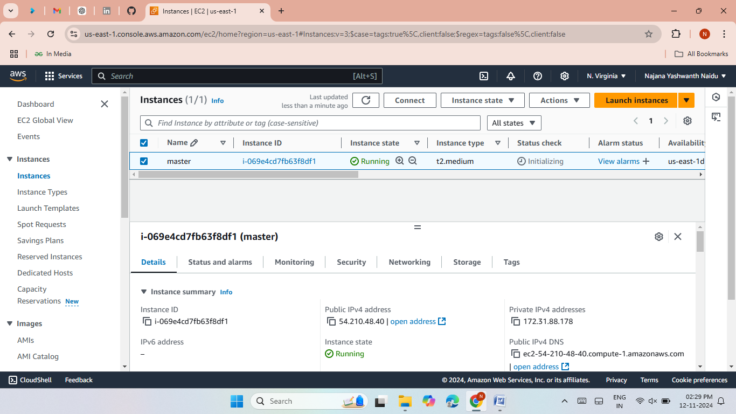
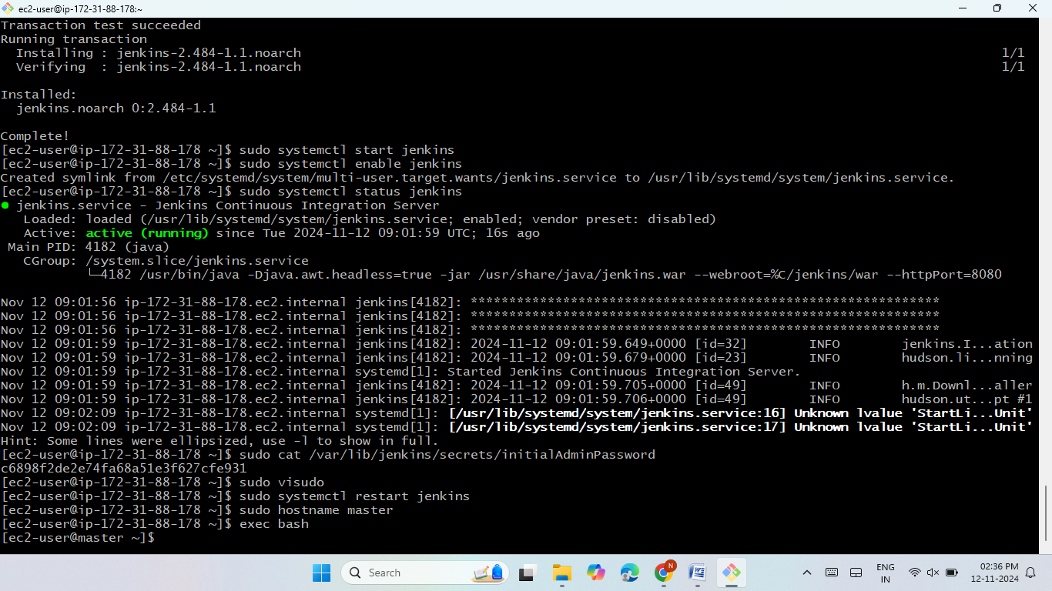
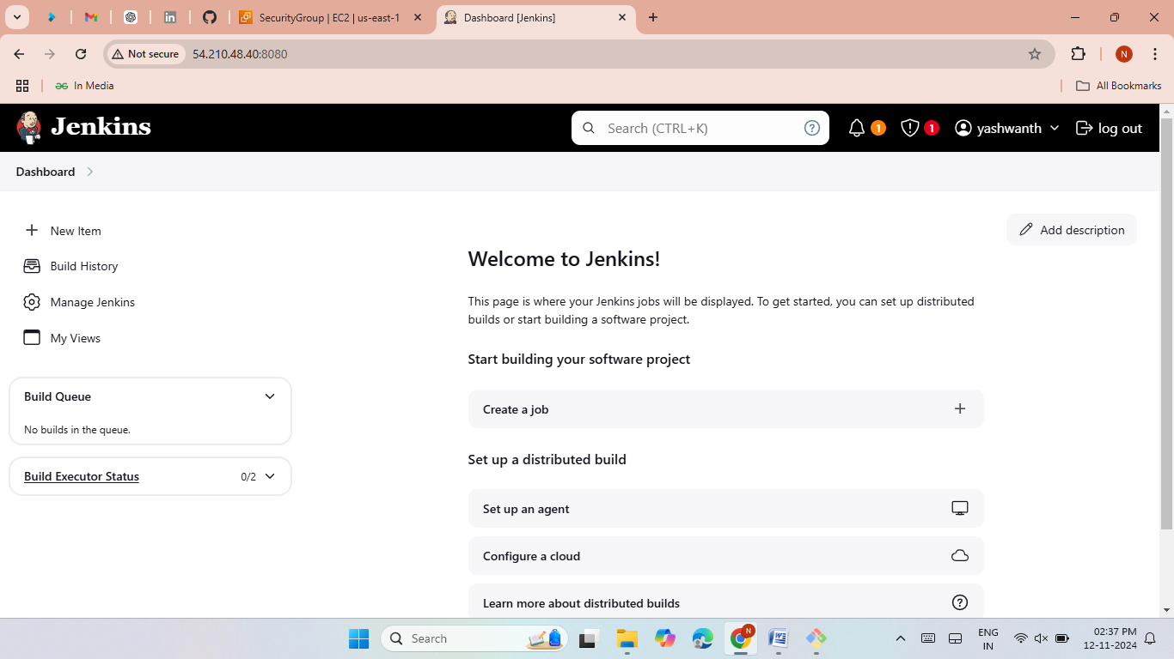
Method-1
Create one master and five slave nodes
launch an master server with the Jenkins port 8080
install java and git.
install Jenkins then start and enable the Jenkins.
Generate keys with the command ssh-keygen.
Launch jenkins.

Slide 4
Install nginx (Slave-1)
Launch an EC2 Instances and give name as slave1.
Now connect Slave1 to local then install java.
Now give private keys from master server.
create a node for slave1 server in jenkins.
create a job and give slave1 label.
Now install nginx and then start and enable.
Now copy the slave1 Public IP and past it on Google browser.
The nginx web server was hosted successfully.

Slide 5
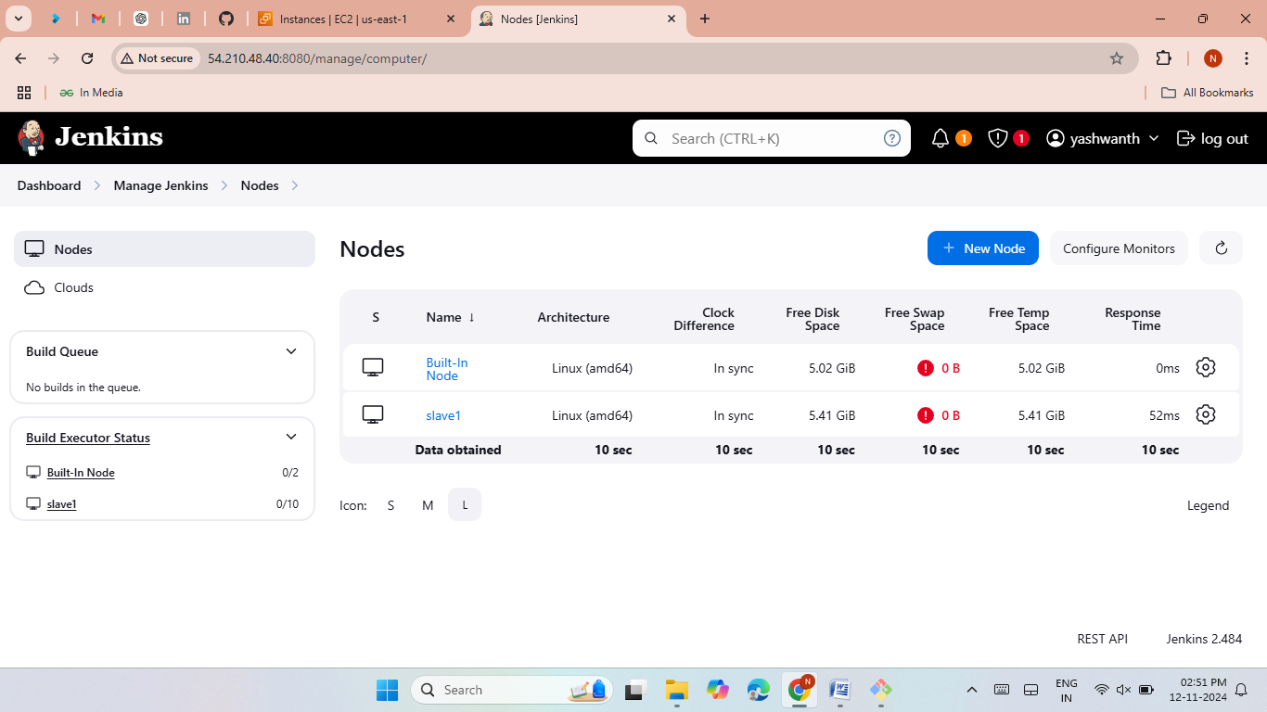
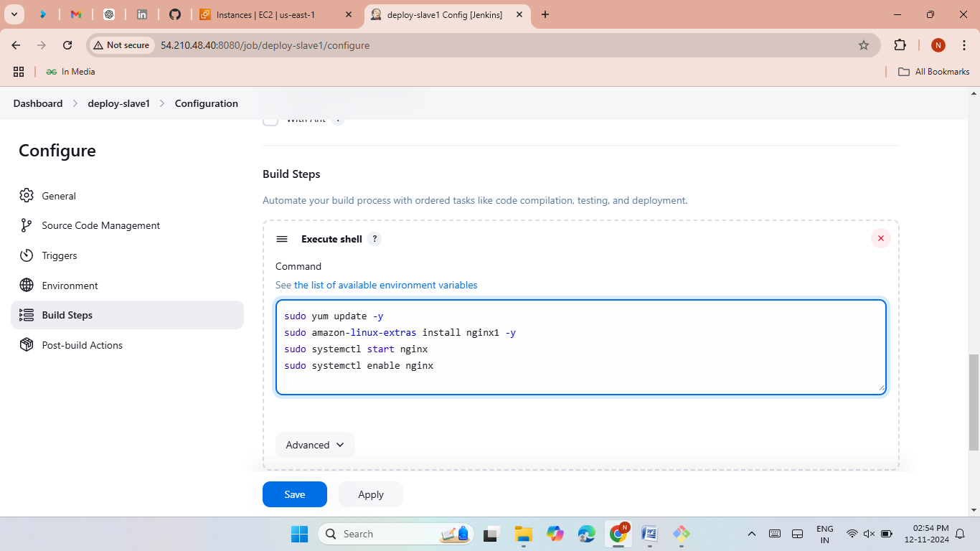
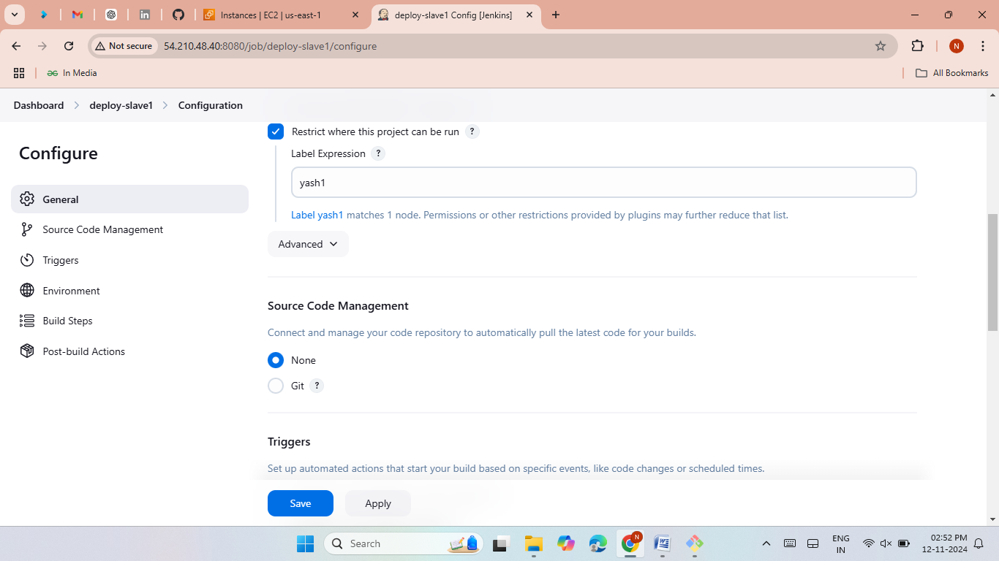
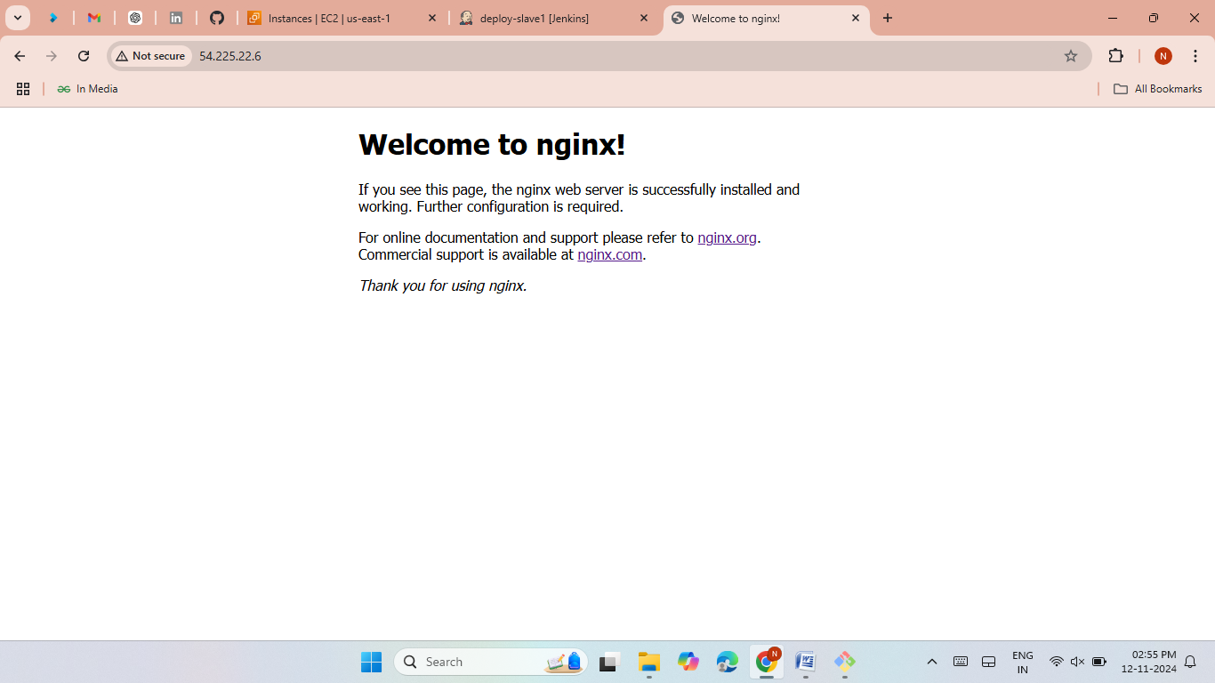

Slide 6

Install httpd (Slave-2)
Launch an EC2 Instances and give name as slave2
Now connect Slave2 to local then install java.
Now give private keys from master server.
create a node for slave1 server in jenkins.
create a job and give slave2 label.
Now install httpd and then start and enable
Now copy the slave2 Public IP and past it on Google browser.
The httpd web server was hosted successfully

Slide 7
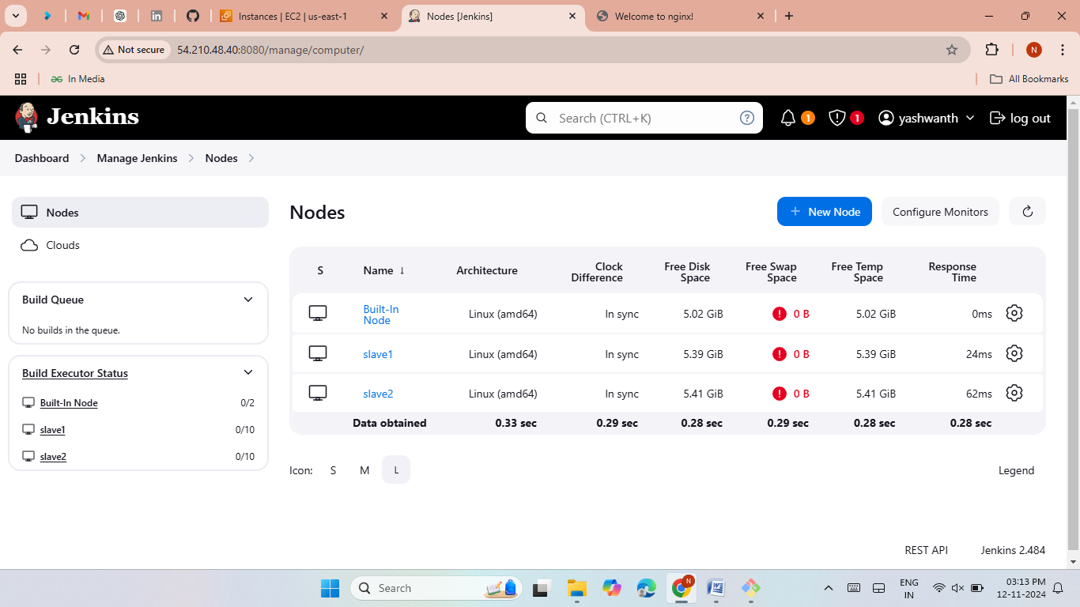

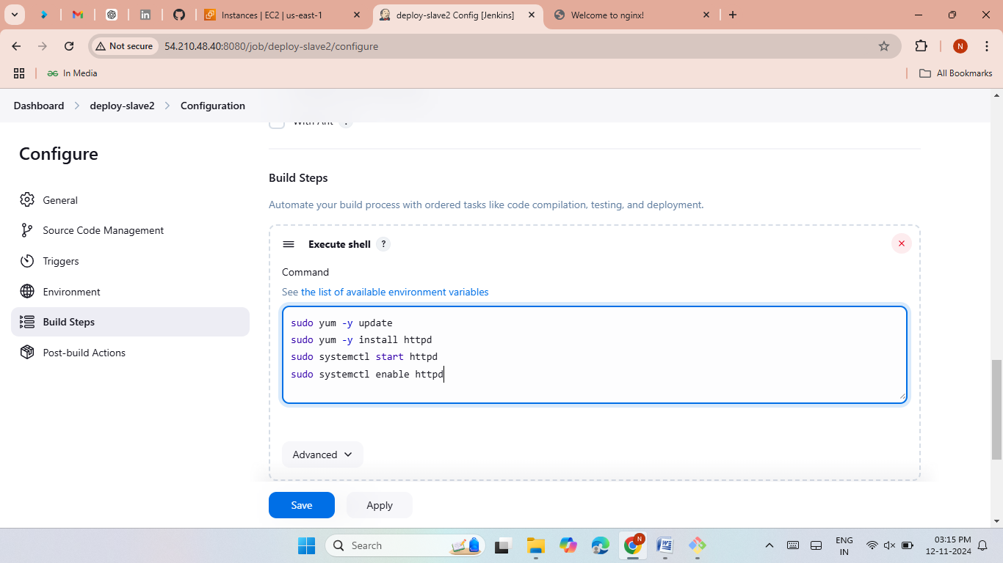
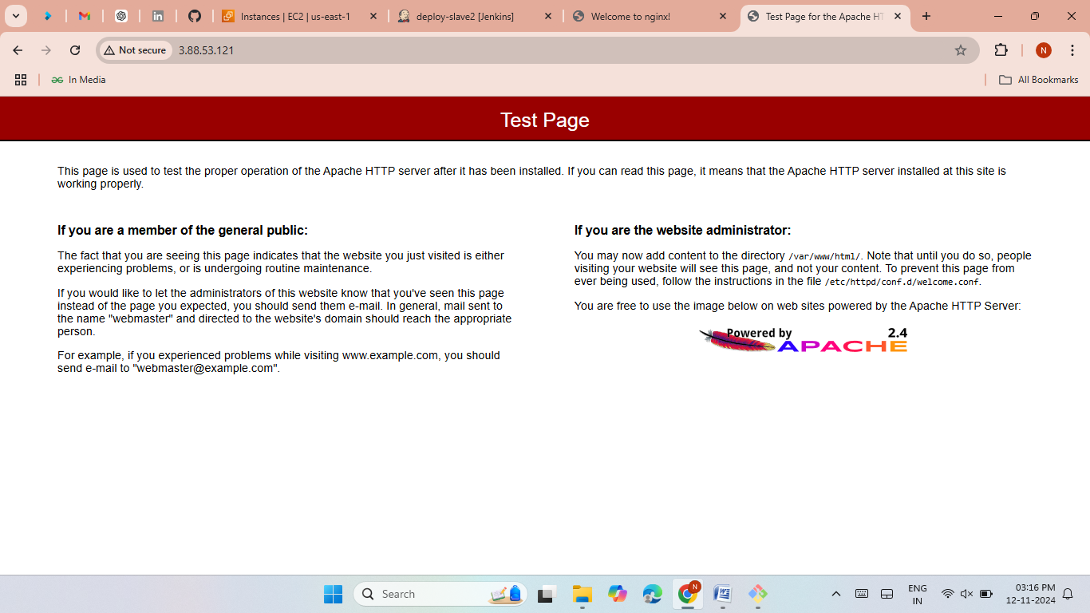

Slide 8
Launch SonarQube (Slave-3)
Launch an EC2 Instances and give name as slave3.
Now connect Slave3 to local then install java.
Now give private keys from master server.
create a node for slave3 server in jenkins.
create a job and give slave3 label.
Now install docker and then start and enable.
Pull the sonarqubes image from dockerhub.
Now copy the slave3 Public IP along with port 9000 and past it on Google browser.
The sonarqube was hosted successfully.

Slide 9
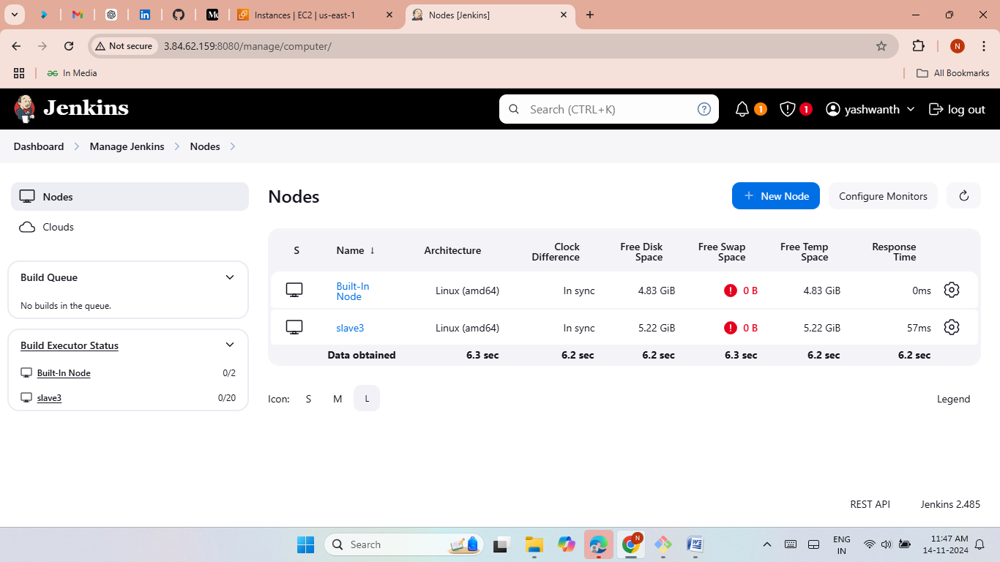
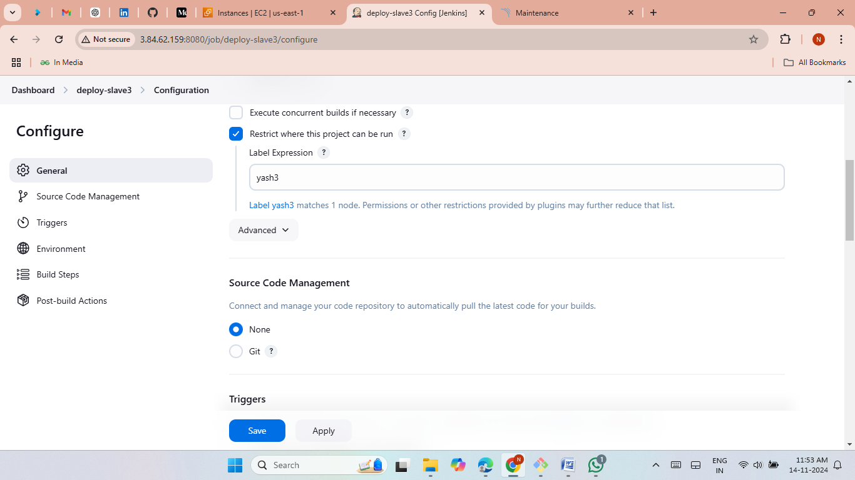
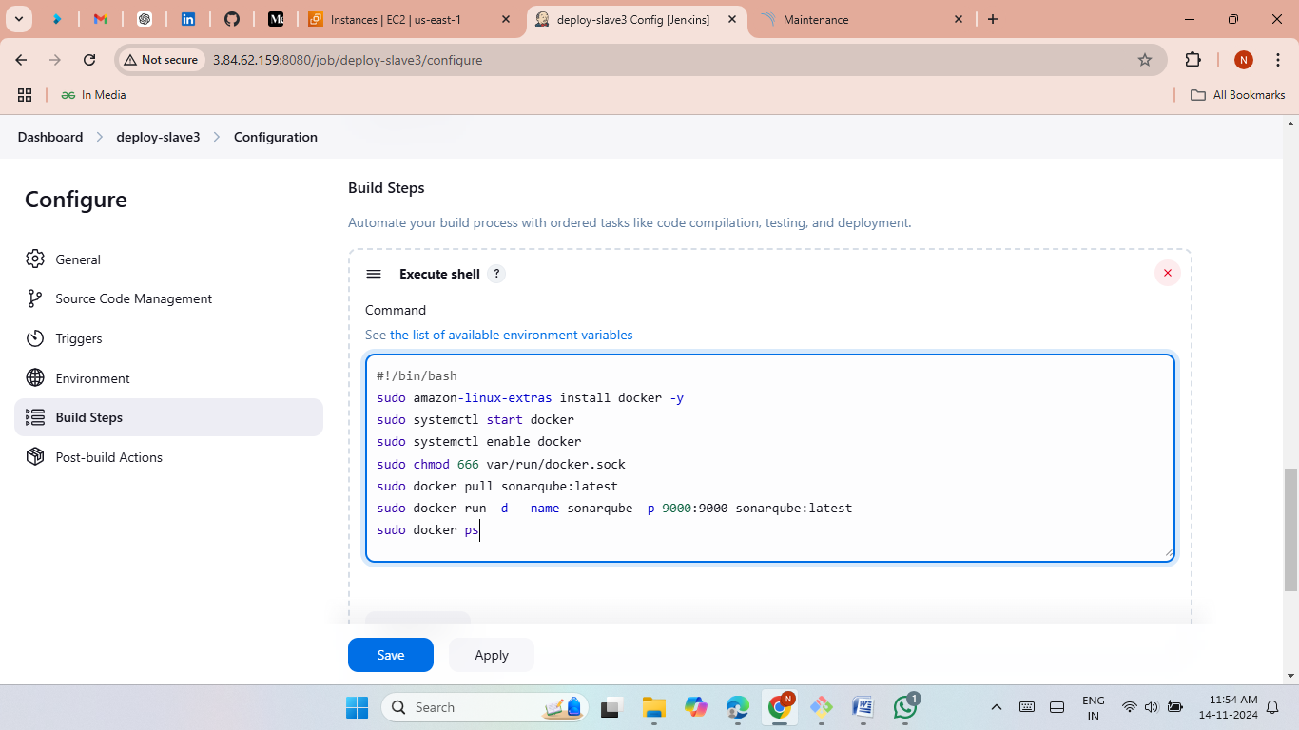
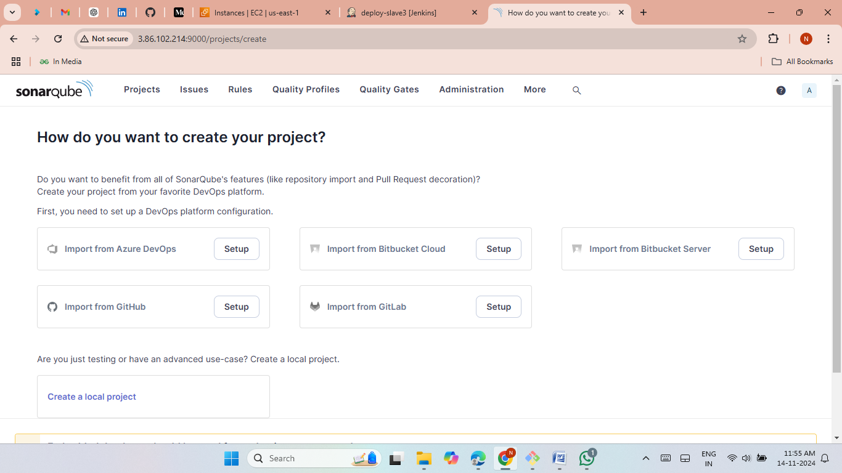

Slide 10


Launch tomcat (Slave-4)
Launch an EC2 Instances and give name as slave4.
Now connect Slave4 to local then install java.
Now give private keys from master server.
create a node for slave4 server in jenkins.
create a job and give slave4 label.
Now install Tomcat from Google and then start the Tomcat.
Now copy the slave4 Public IP along with port 8080 and past it on Google browser.
The Tomcat was hosted successfully.

Slide 11
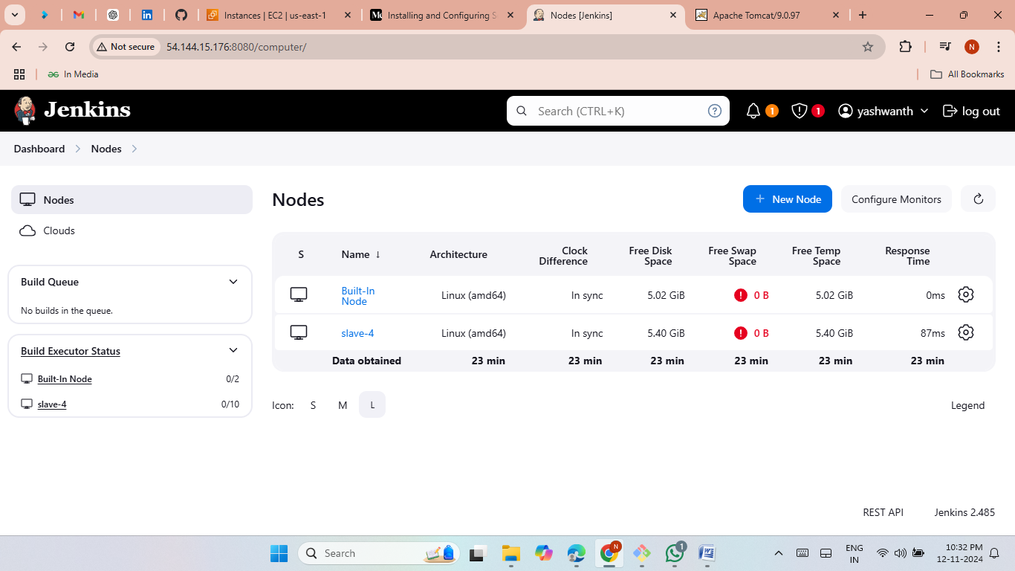
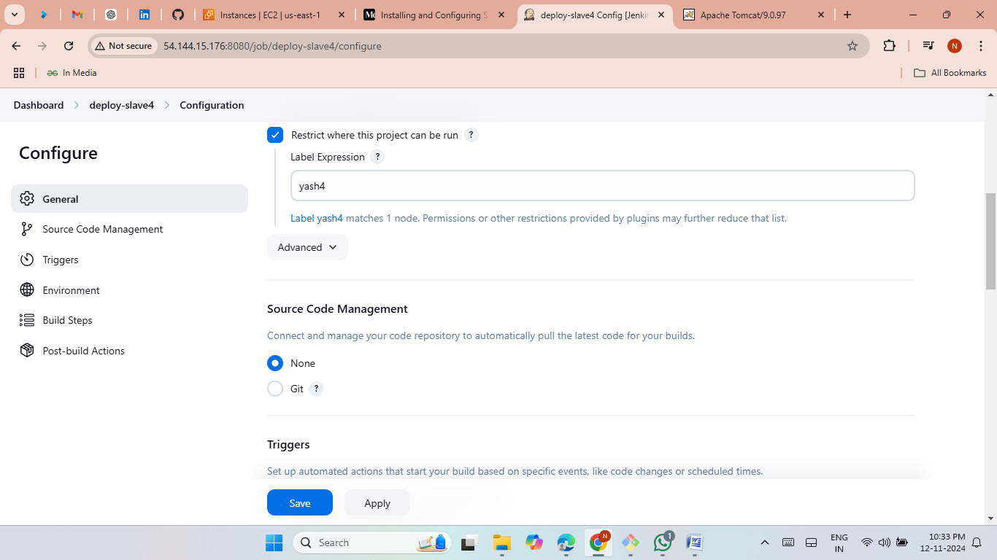
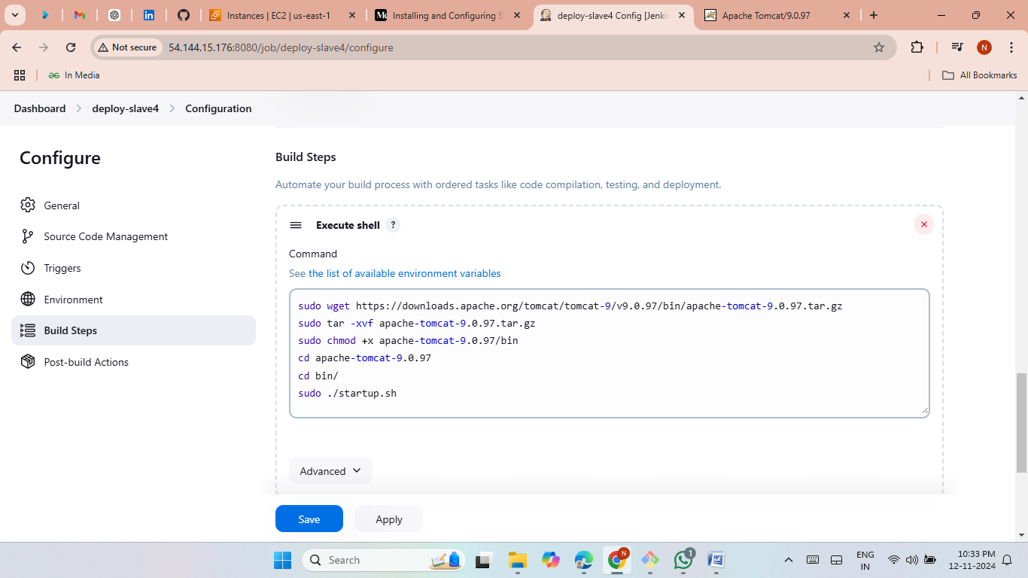
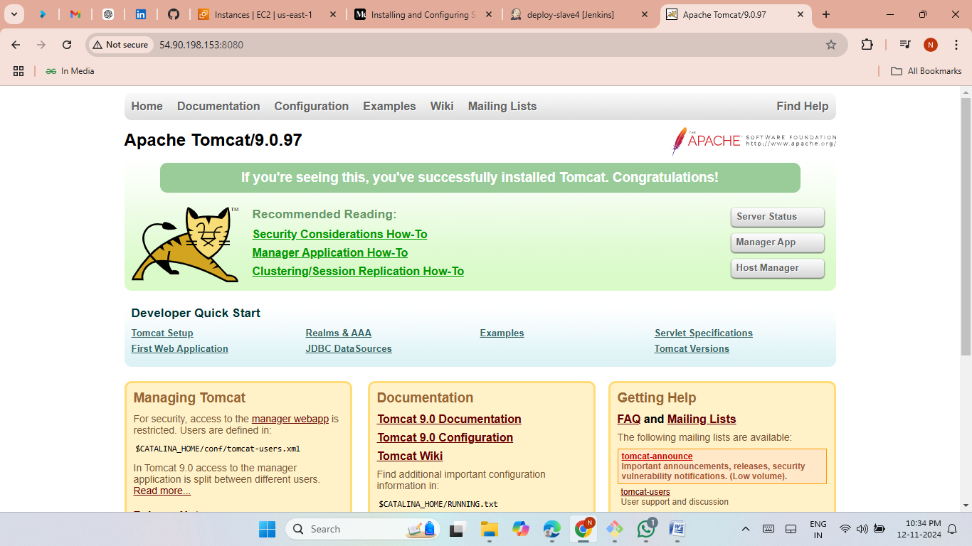

Slide 12
Deploy Static application in httpd web servers (Slave-5)
Launch an EC2 Instances and give name as slave5.
Now connect Slave5 to local then install java.
Now give private keys from master server.
create a node for slave5 server in jenkins.
create a job and give slave5 label.
Clone the static ecomm application.
Now install httpd and then start and enable in jenkins.
Set the path (/var/www/html/).
Now copy the slave5 Public IP and past it on Google browser.
The ecomm web application was hosted successfully.

Slide 13
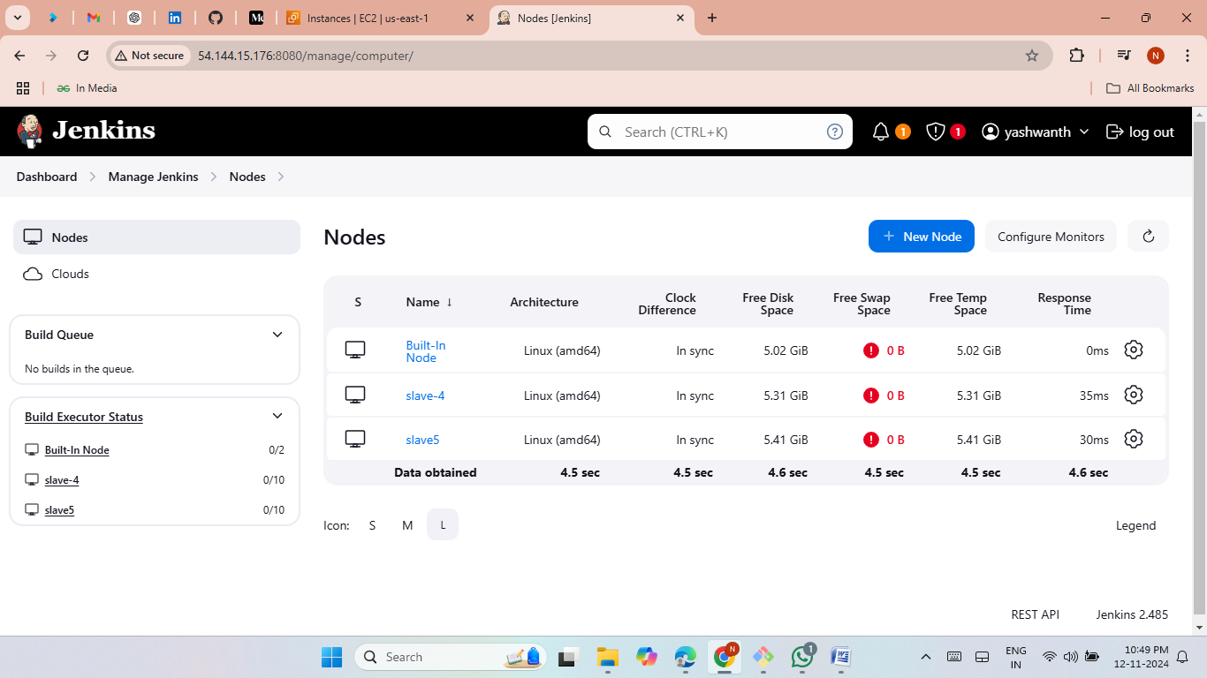
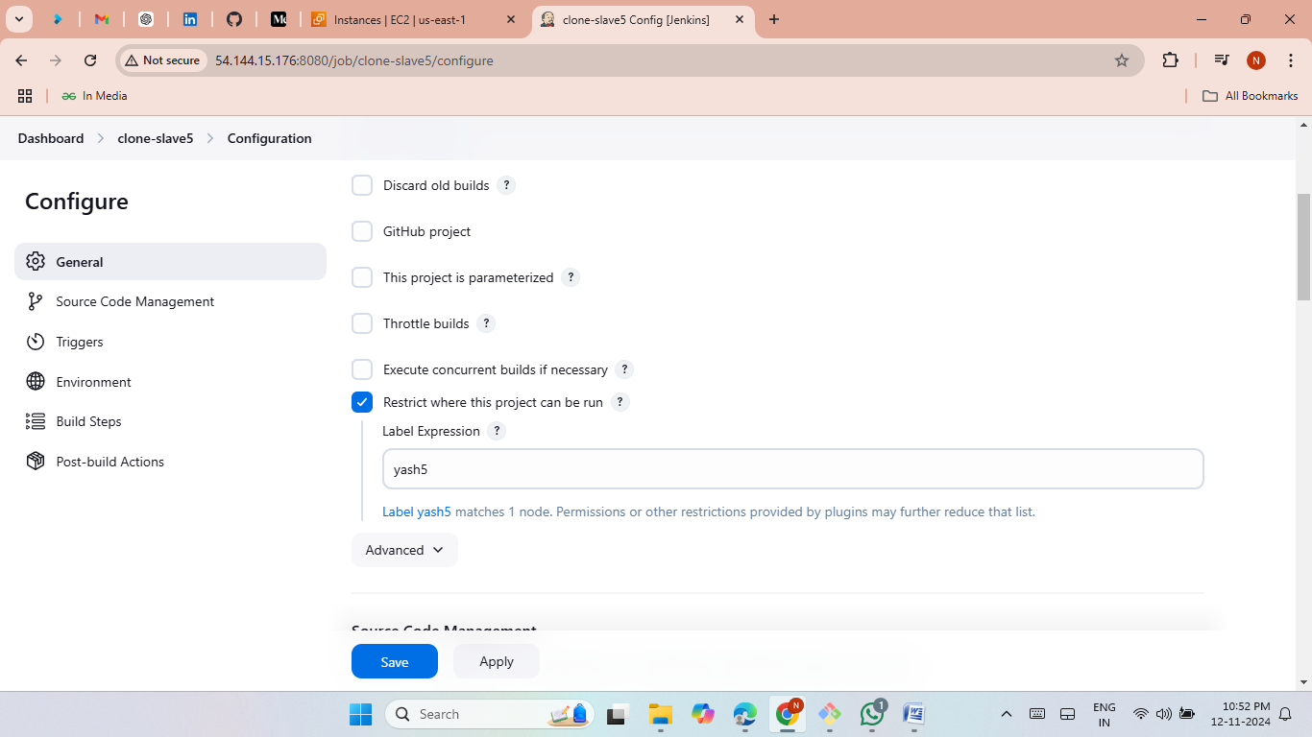
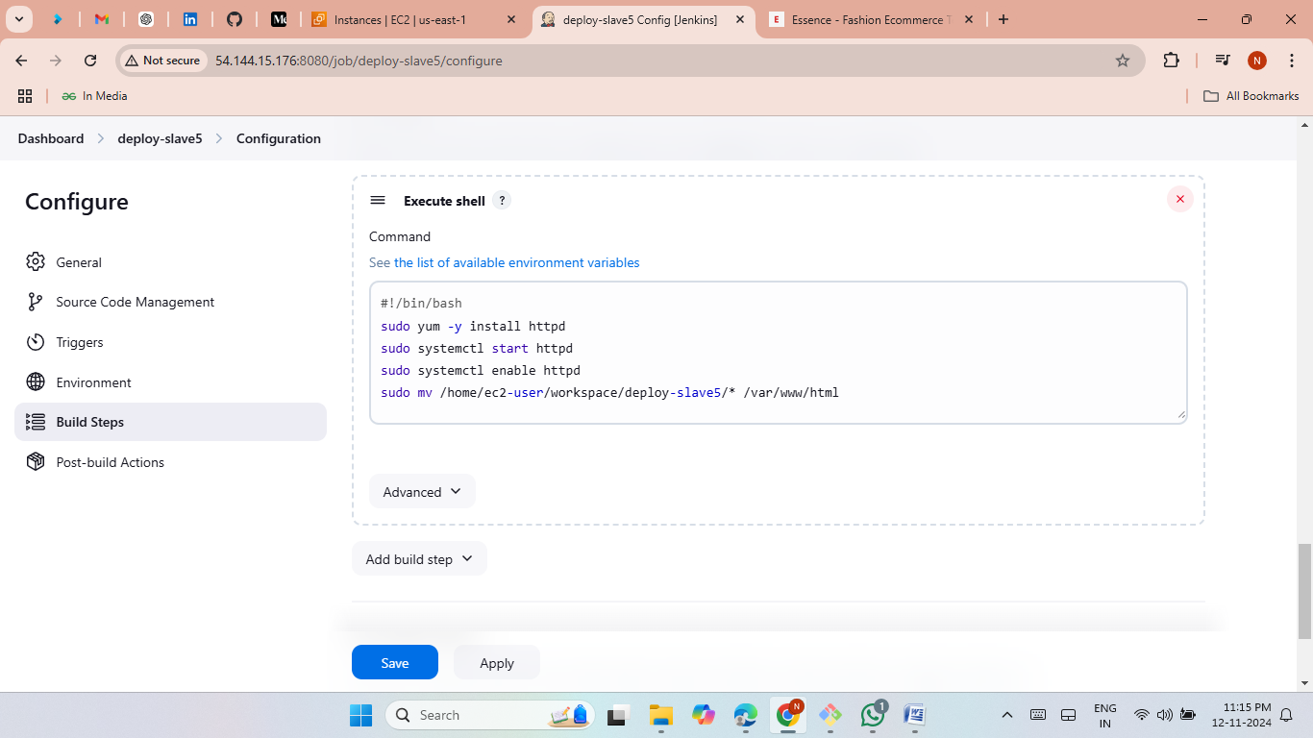
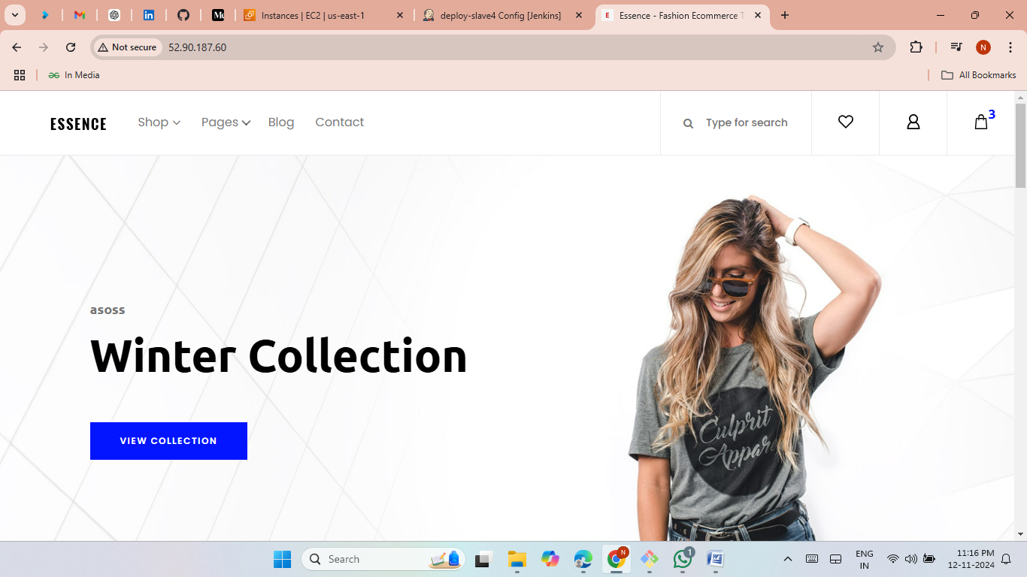

Slide 14
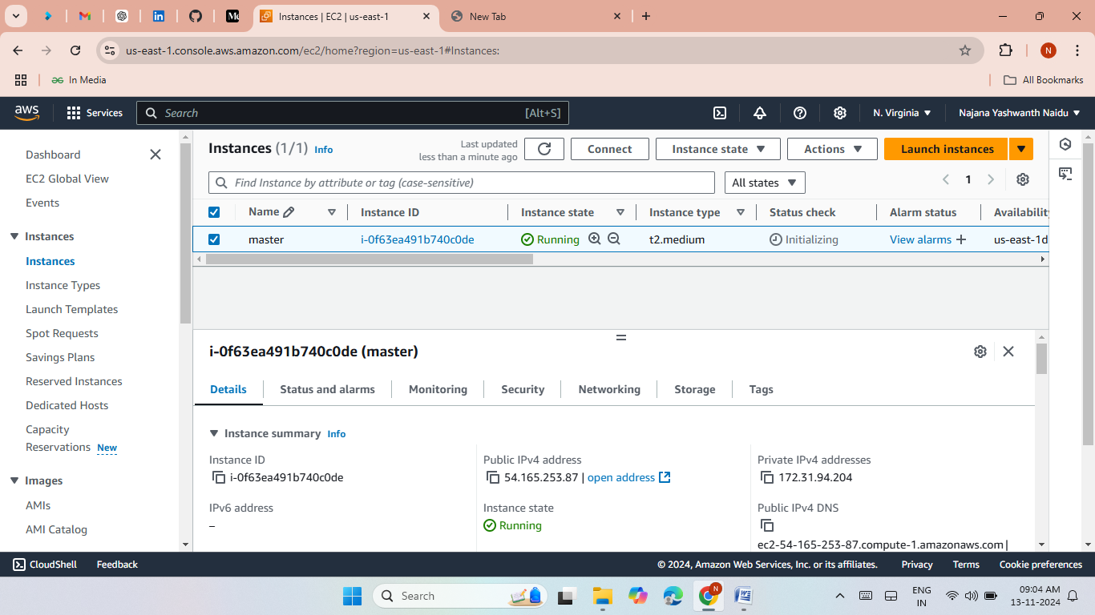
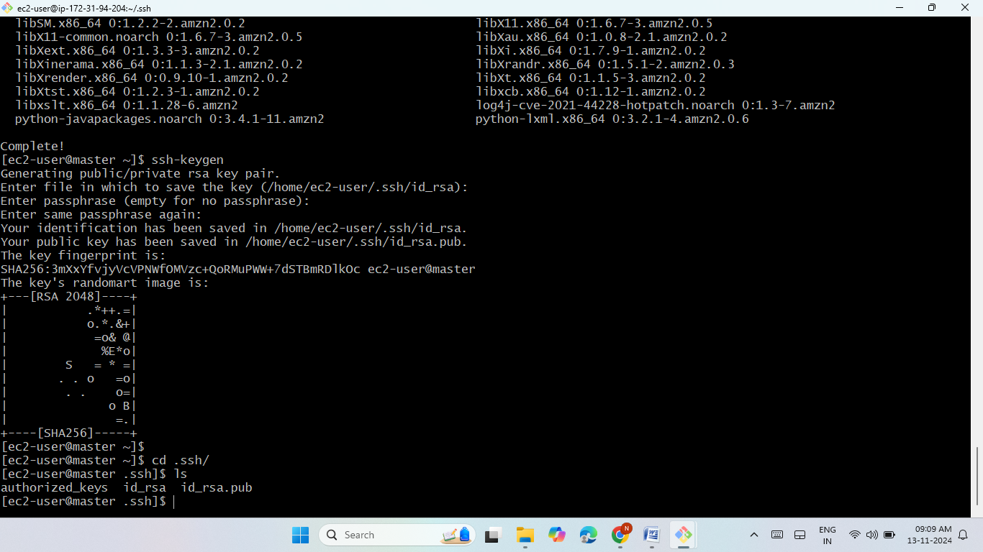

Method-2
Create one master and five slave nodes
launch an master server with the Jenkins port 8080
install java and git.
install Jenkins then start and enable the Jenkins.
Generate keys with the command ssh-keygen.
Launch jenkins page.

Slide 15
Deploy python web applications through manually (Slave-1)
Launch an EC2 Instances and give name as slave1.
Now connect Slave1 to local then install java.
Now give private keys from master server.
create a node for slave1 server in jenkins.
create a job and give slave1 label.
Clone the python application from github.
Now install python3 and pip3 requirements manually.
Run the python application with the command screen –m –d python3 app.py.
Now copy the slave1 Public IP and past it on Google browser.
The python application was hosted successfully.

Slide 16
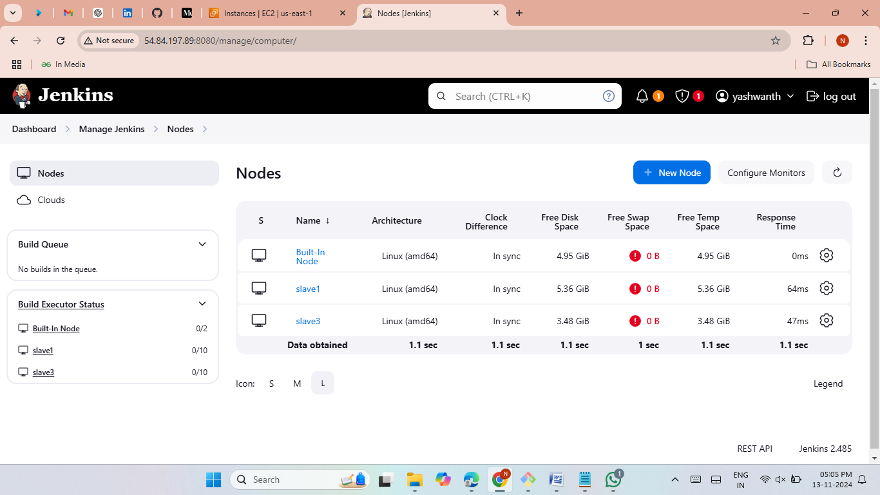
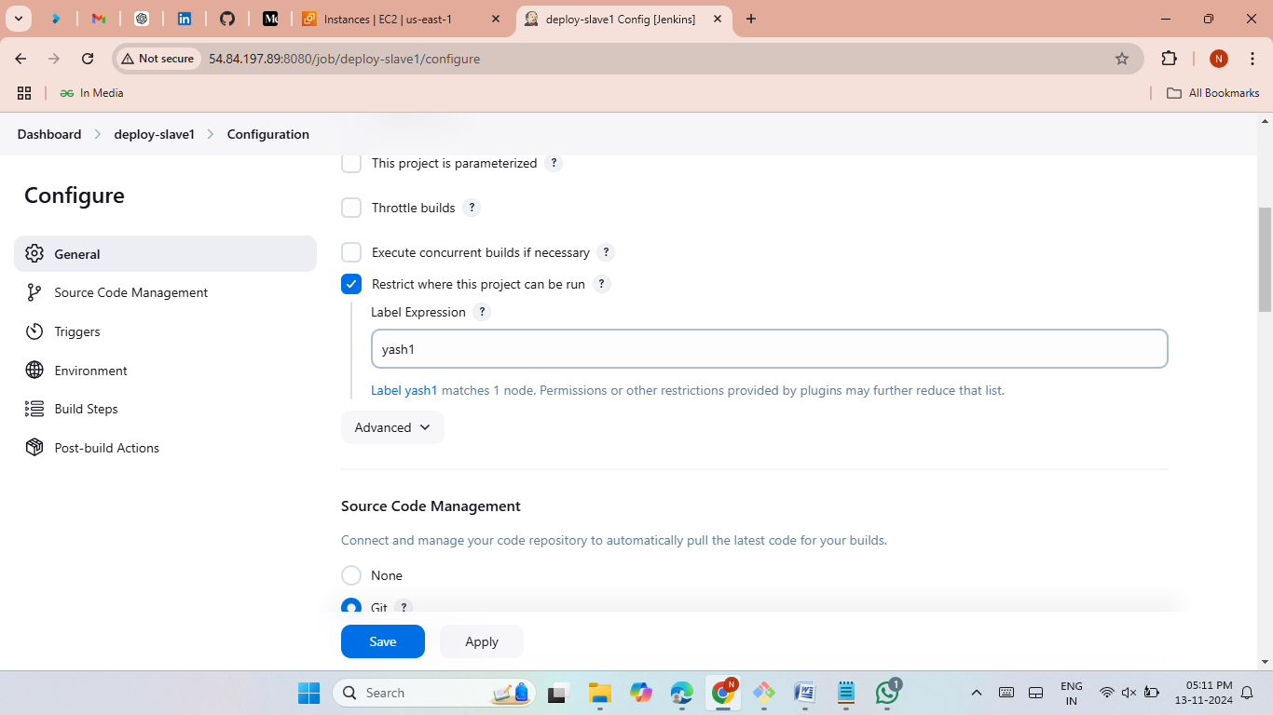
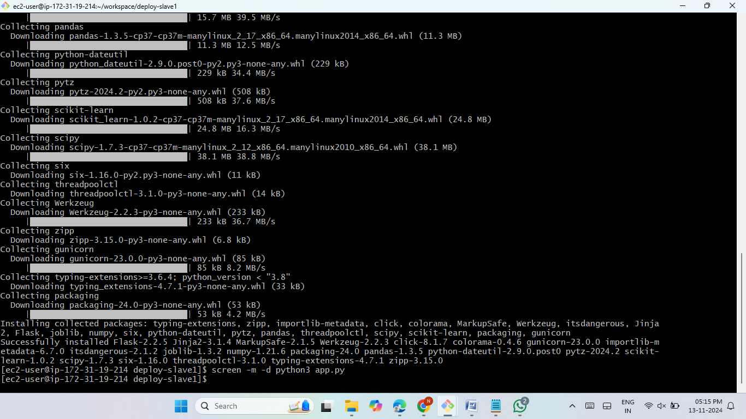
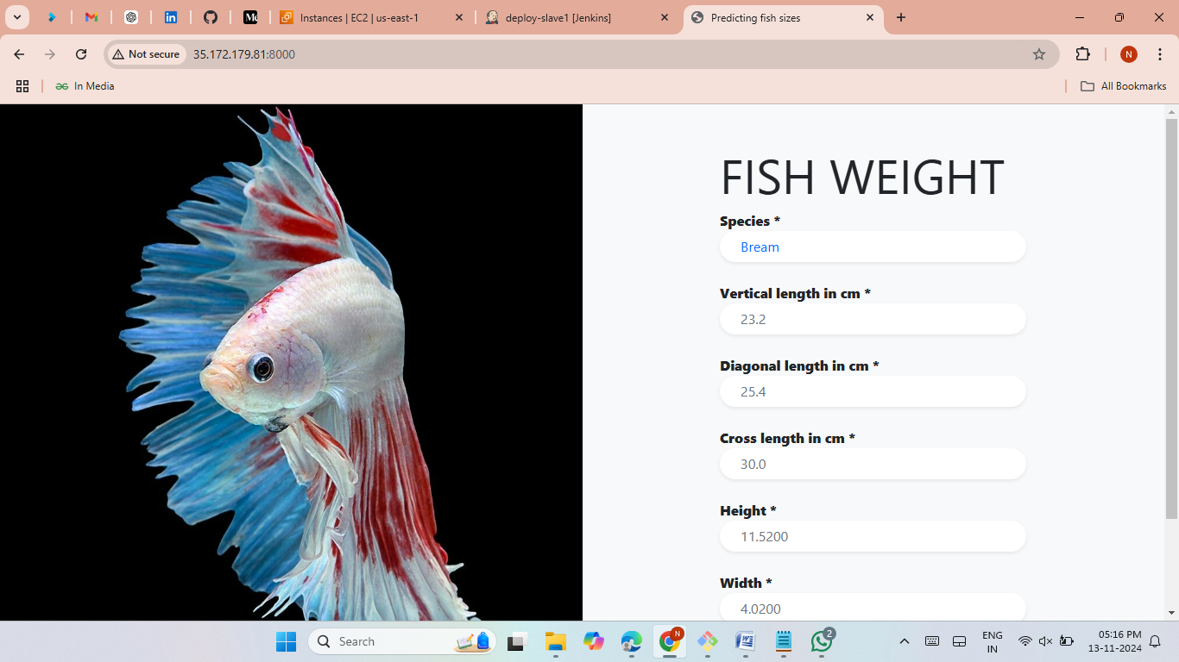

Slide 17
Deploy python web applications through bash script (Slave-2)
Launch an EC2 Instances and give name as slave2.
Now connect Slave2 to local then install java.
Now give private keys from master server.
create a node for slave2 server in jenkins.
create a job and give slave2 label.
Clone the python application from github.
Now install python3 and pip3 requirements in jenkins execute shell.
Run the python application with the command screen –m –d python3 app.py in jenkins.
Now copy the slave2 Public IP and past it on Google browser.
The python application was hosted successfully.

Slide 18
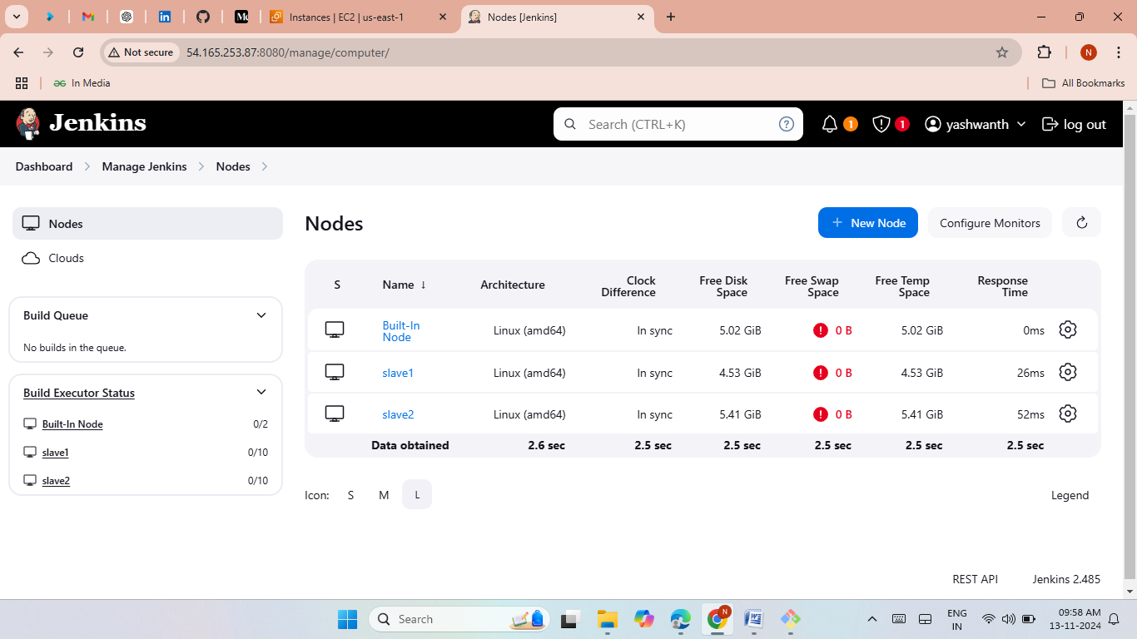
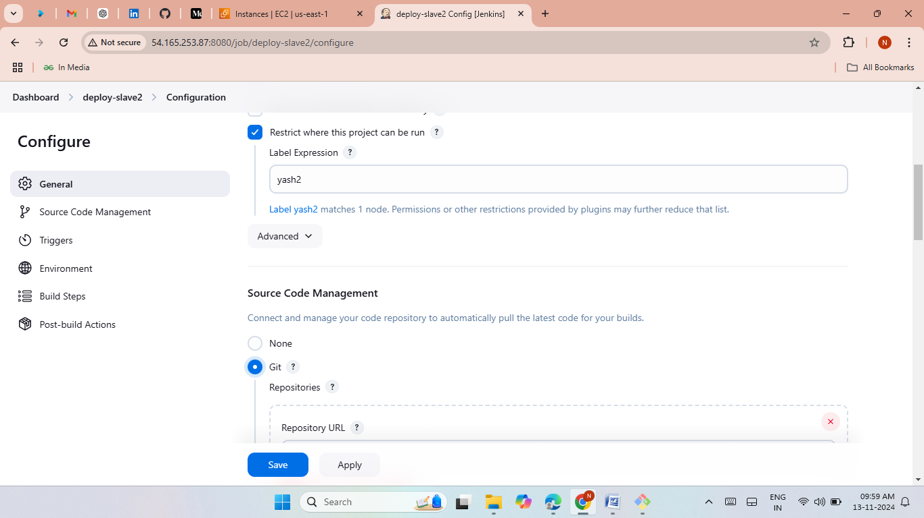
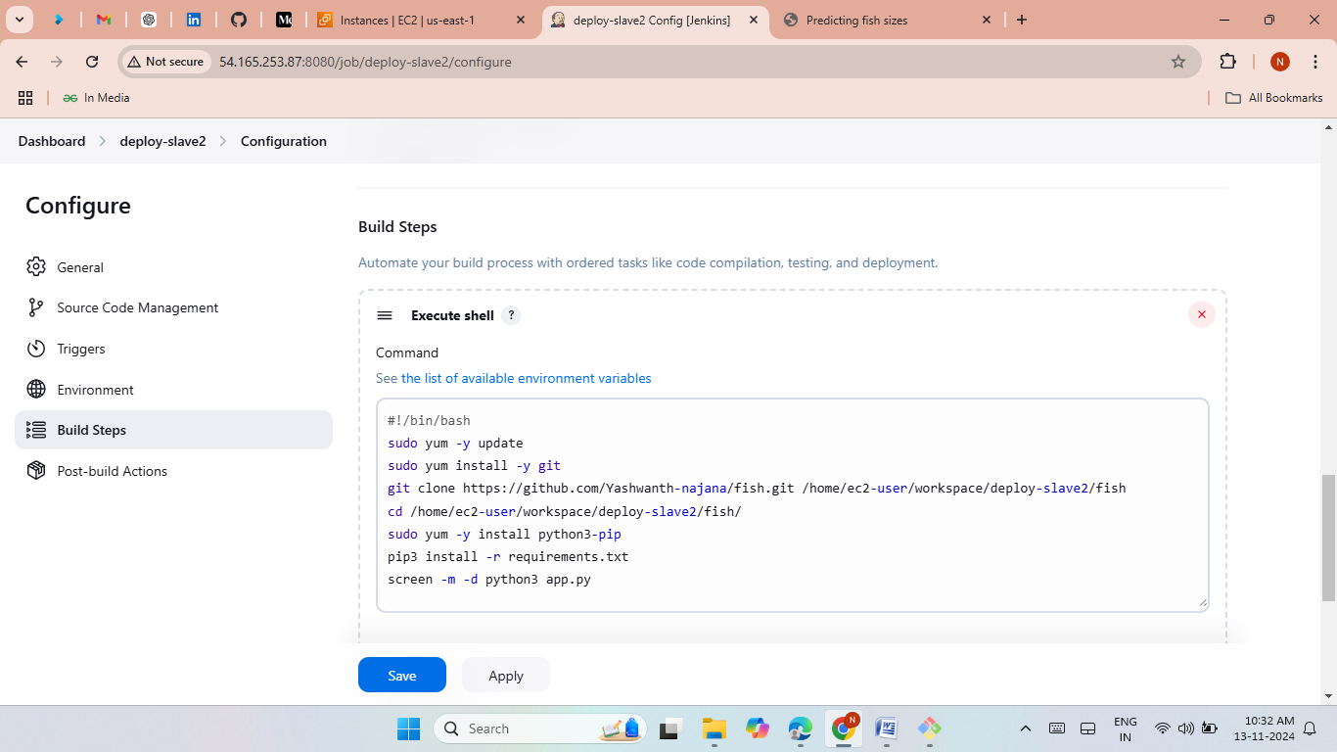


Slide 19
Deploy python web applications through terraform (Slave-3)
Launch an EC2 Instances and give name as slave3.
Now connect Slave3 to local then install java.
Now give private keys from master server.
create a node for slave3 server in jenkins.
create a job and give slave3 label.
Clone the terraform script from github.
Give IAM credentials to jenkins.
Now install terraform in jenkins execute shell. Run the terraform script with terraform commands.
Run the terraform script with terraform commands.
The terraform resources was created.
Now copy the slave3 Public IP and past it on Google browser.
The python application was hosted successfully.

Slide 20
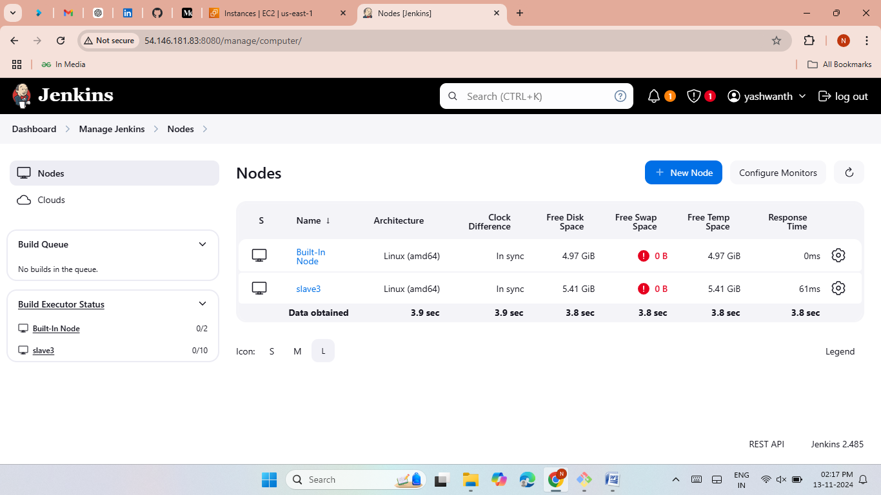
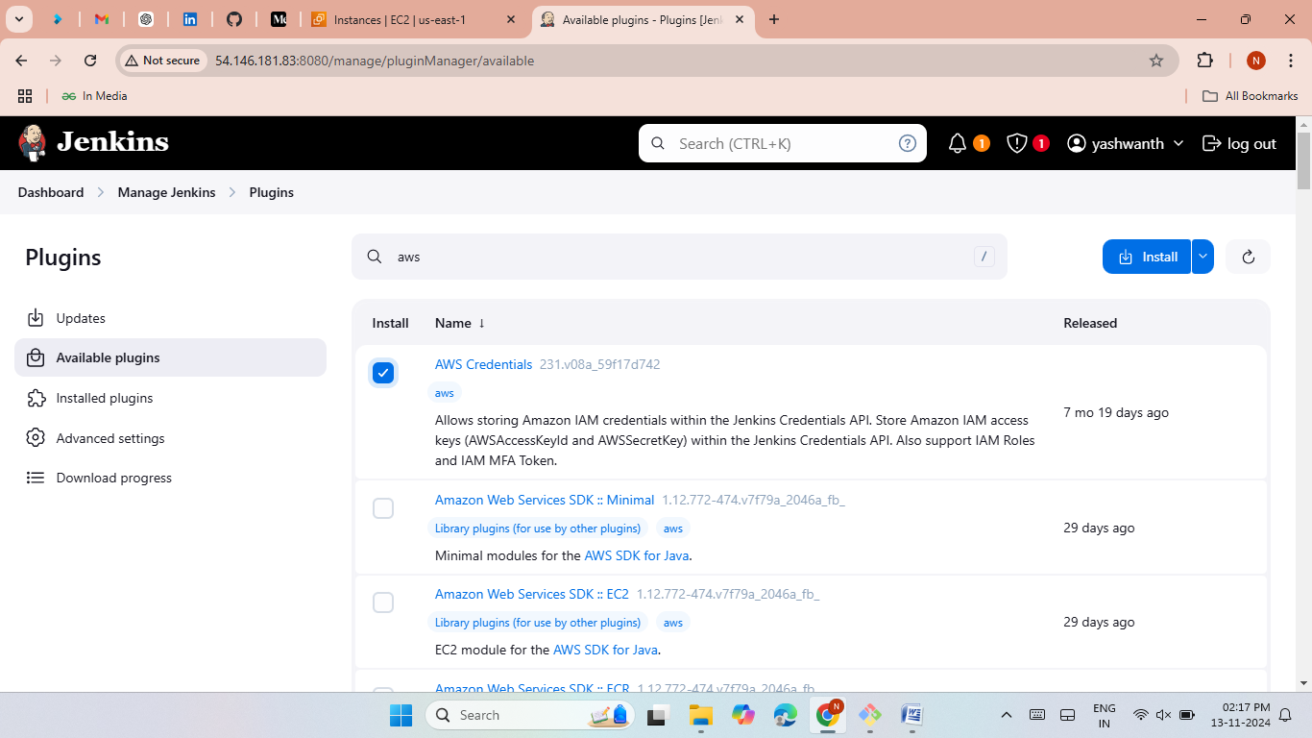
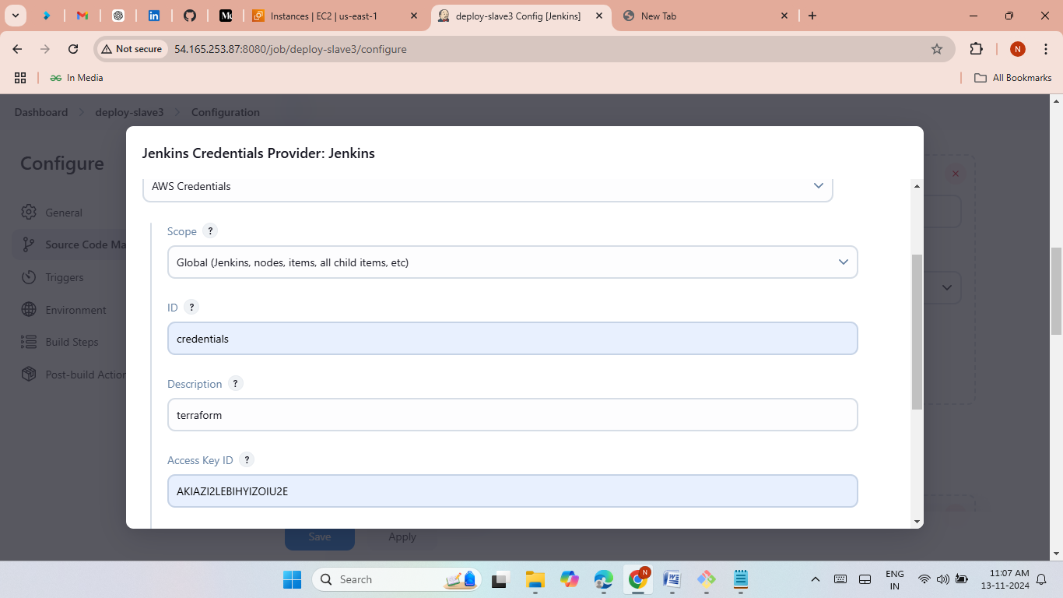
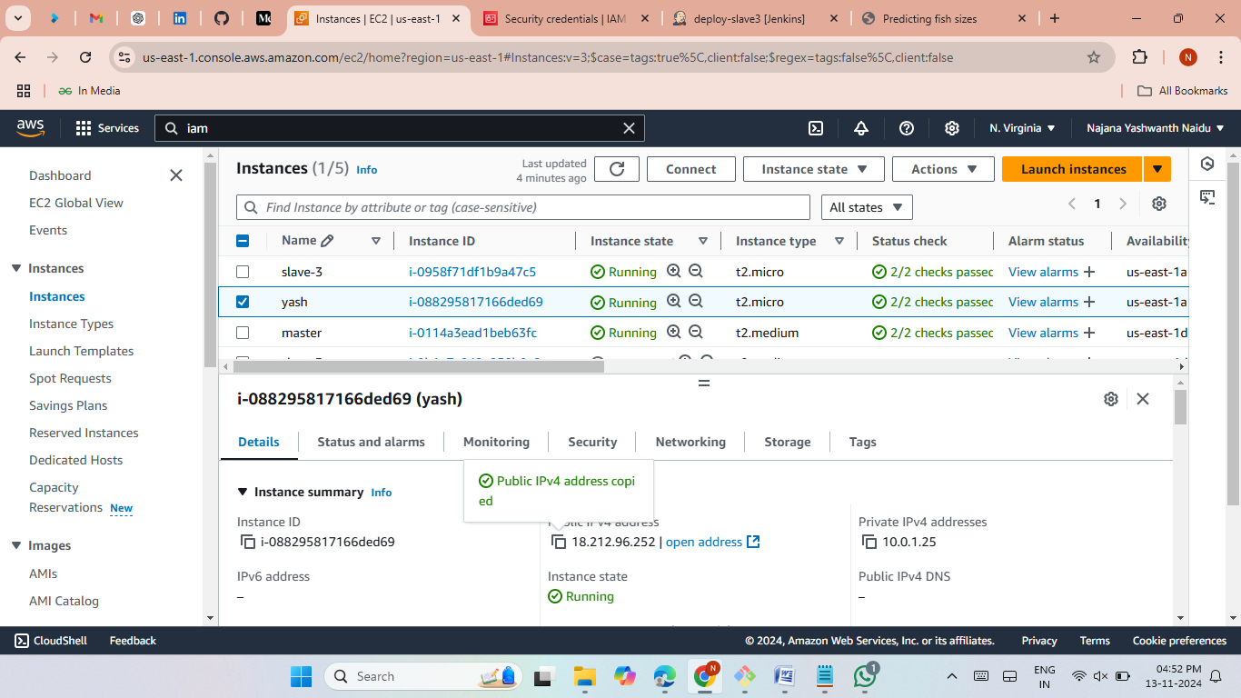
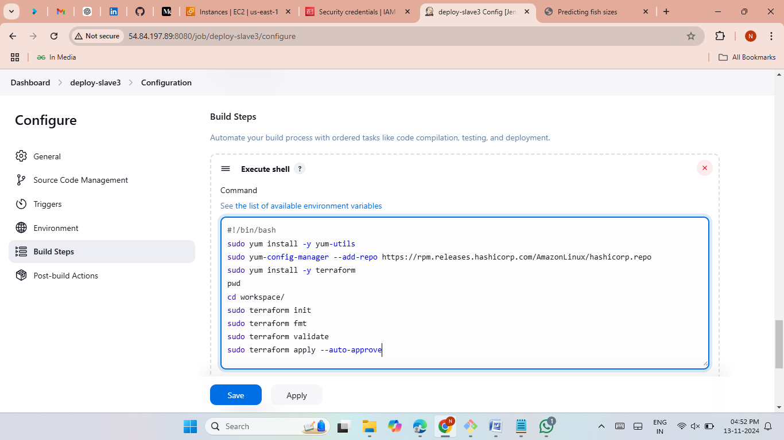
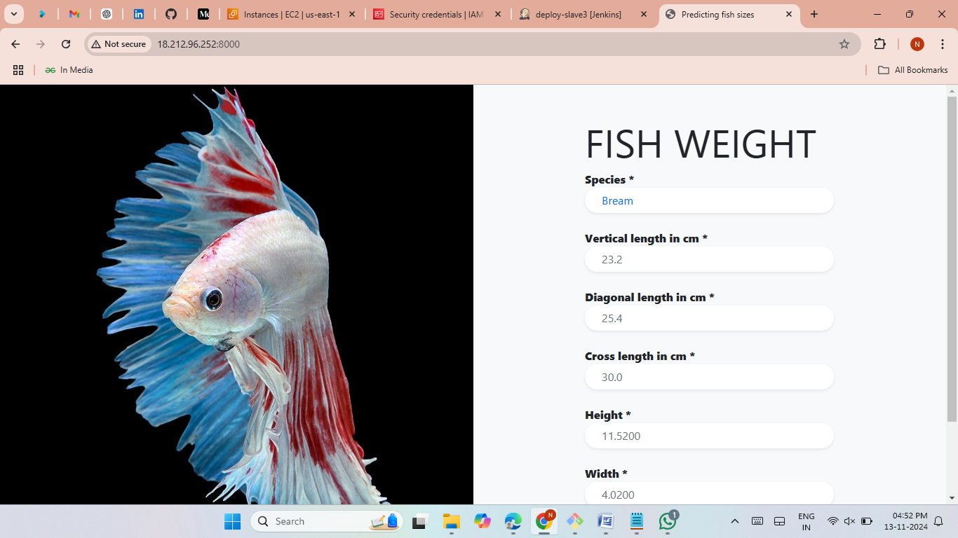

Slide 21
Deploy Java-based application through manually (Slave-4)
Launch an EC2 Instances and give name as slave4.
Now connect Slave4 to local then install java.
Now give private keys from master server.
create a node for slave4 server in jenkins.
create a job and give slave4 label.
Clone the java application from github.
Create another job Install maven plugin and make some configuration.
Launch another instance then install sonarqubes then connect to jenkins with some configurations in another job.
Create anthoer job and install deploy to continar plugin and make some configurations.
Create pipeline with these 4 jobs and add build periodically, poll scm, webhooks.
Now copy the slave4 Public IP and past it on Google browser.
The java application was hosted successfully.

Slide 22
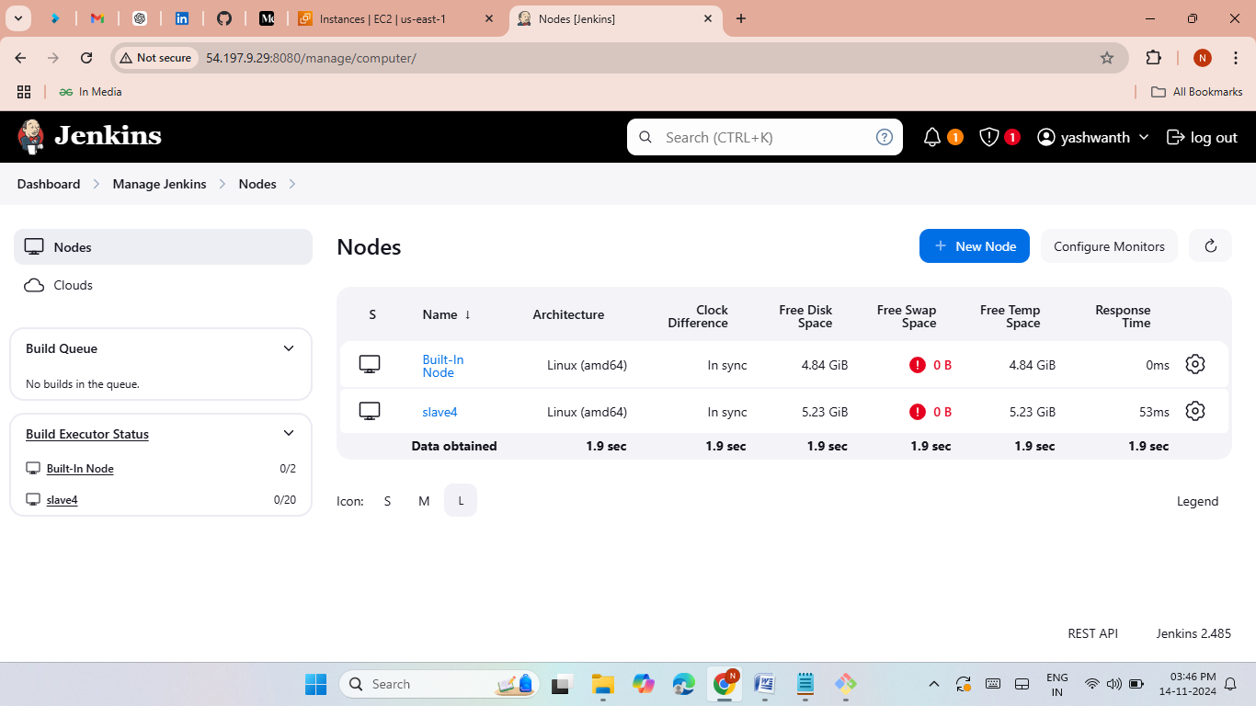
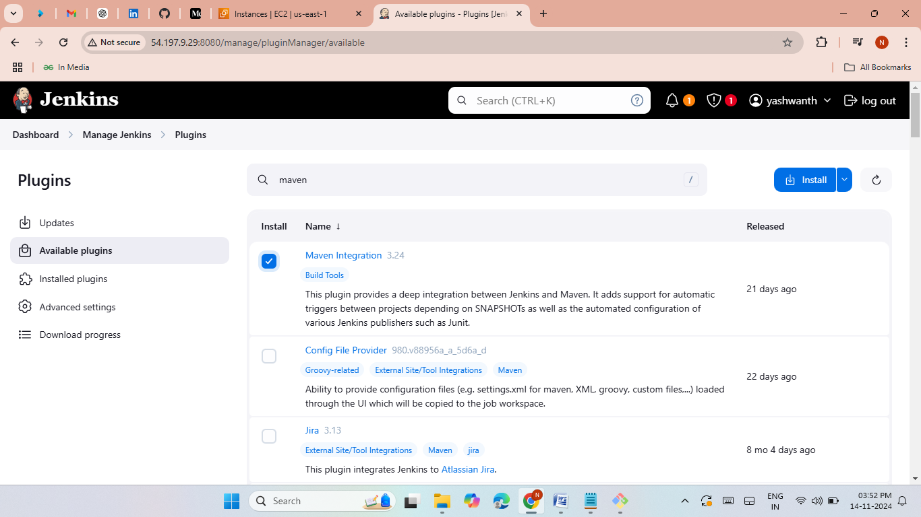
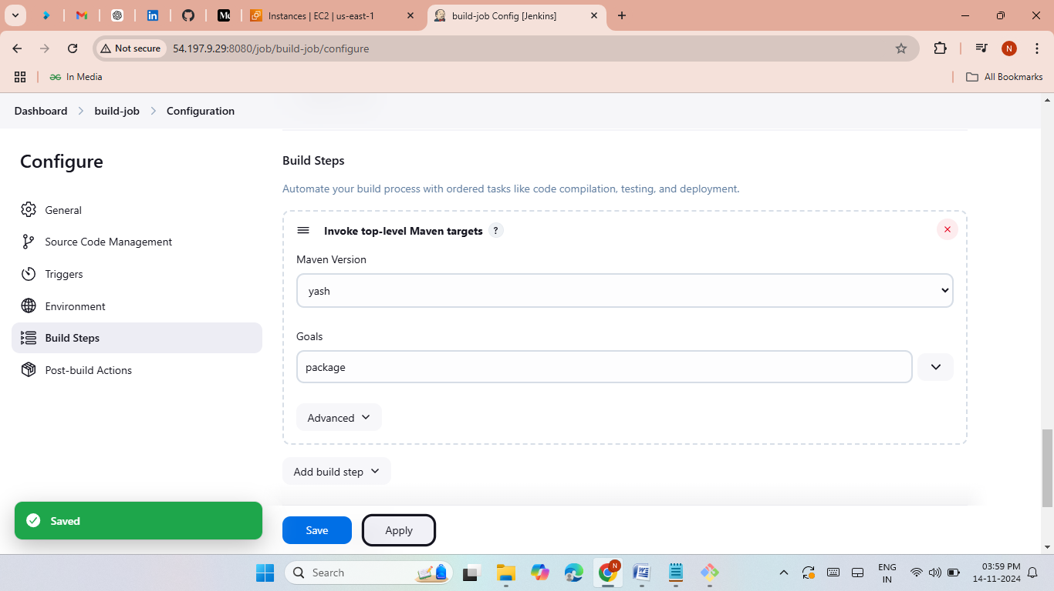
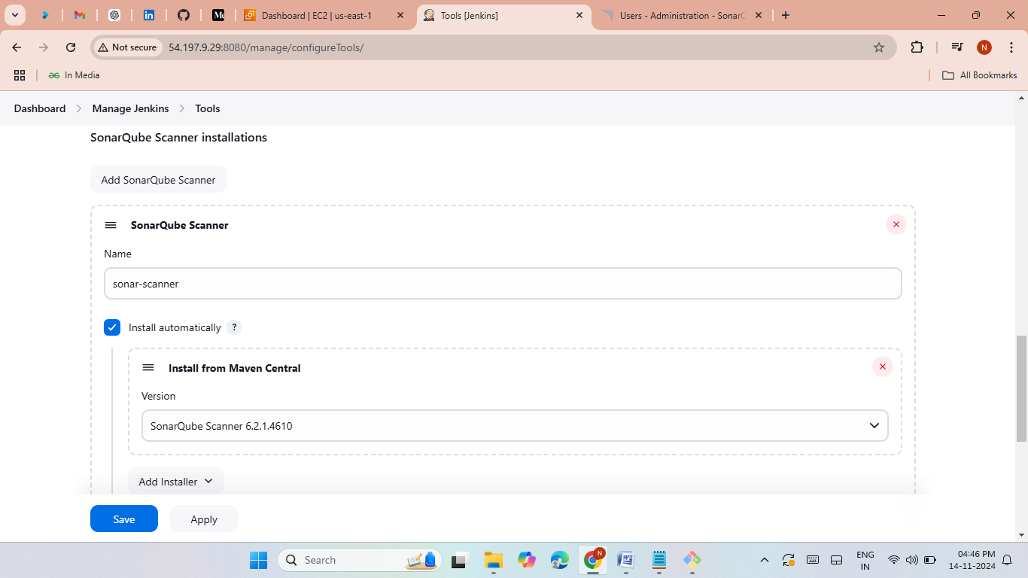
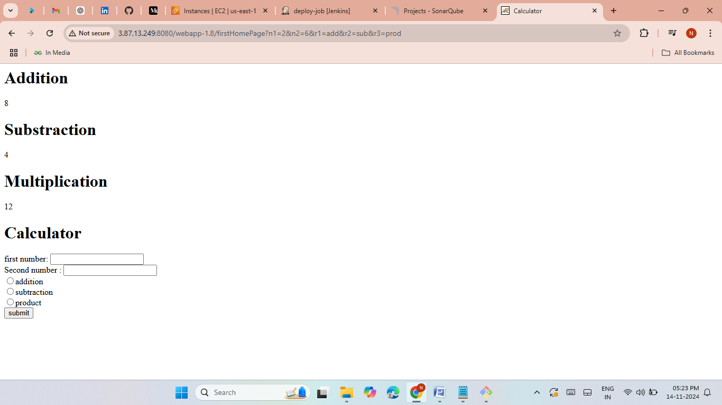
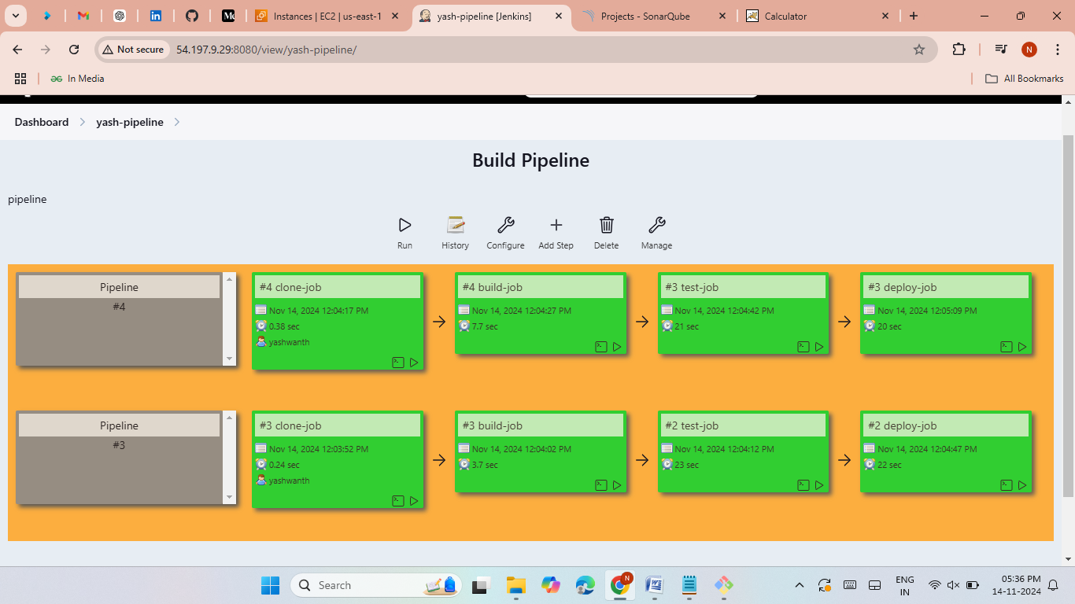

Slide 23
Deploy Java-based application through bash script (execute shell) (Slave-5).
Launch an EC2 Instances and give name as slave5.
Now connect Slave5 to local then install java.
Now give private keys from master server.
create a node for slave5 server in jenkins.
create a job and give slave5 label.
Clone the java application from github.
install tomcat and maven to run the java calculator in jenkins execut shell.
Make some configurations manually.
Now copy the slave5 Public IP and past it on Google browser.
The java application was hosted successfully.

Slide 24

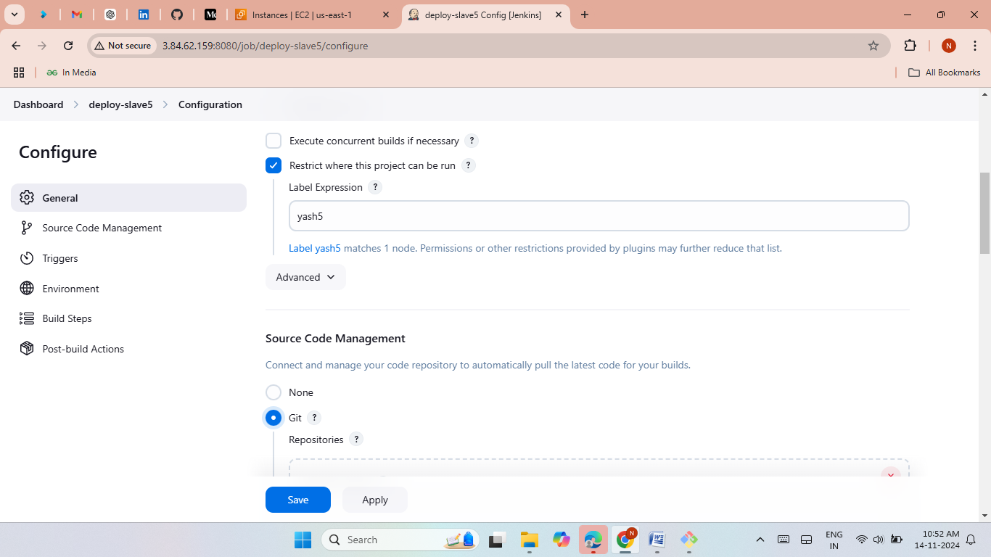
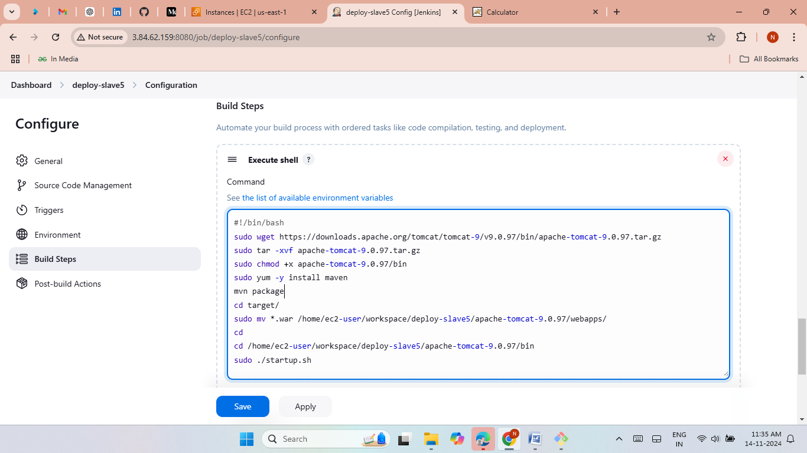
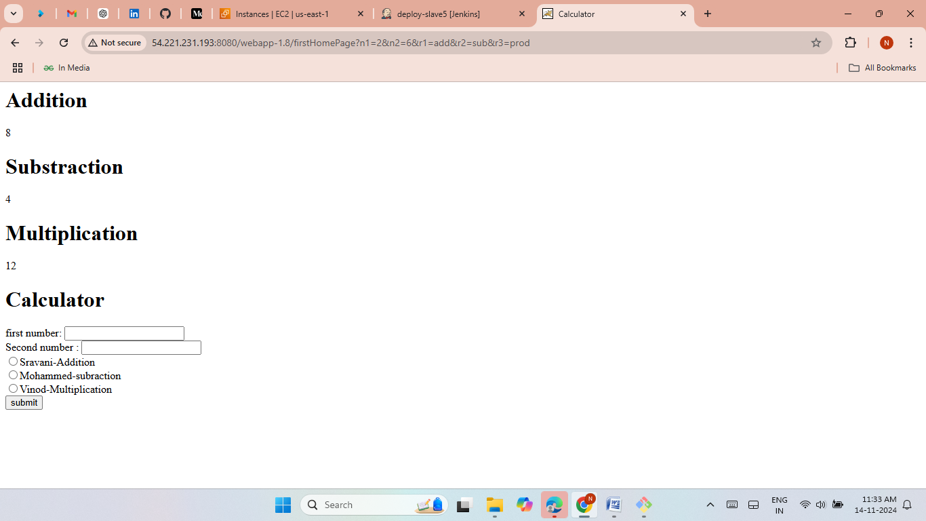

Slide 25
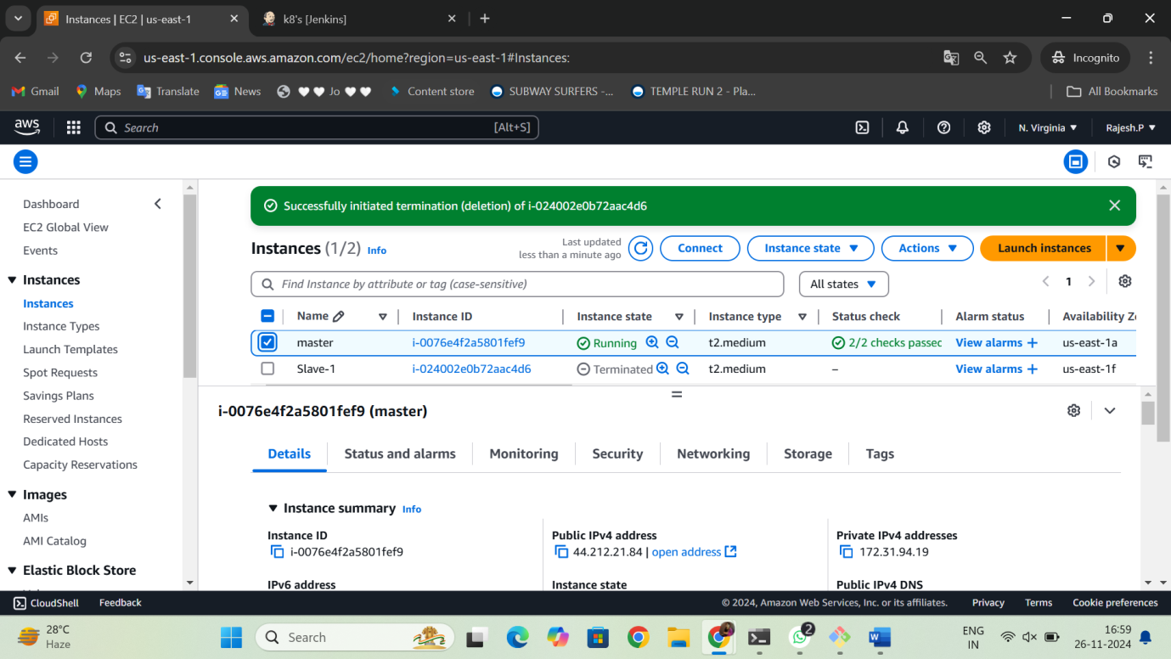
Method-3 (group project)
Rajesh Create master.
launch an master server with the Jenkins port 8080
install java and git.
install Jenkins then start and enable the Jenkins.
Generate keys with the command ssh-keygen.
Launch jenkins page.

Slide 26
Rajesh deploy word press with bash script(slave-5)
Launch an EC2 Instances and give name as slave5
Now connect Slave5 to local then install java.
Now give private keys from master server.
create a node for slave5 server in jenkins.
create a job and give slave5 label.
Clone the wordpress application from github.
Now install docker and docker compose in jenkins.
Run the wordpress application in jenkins job.
Now copy the slave5 Public IP and past it on Google browser.
The wordpress application was hosted successfully.

Slide 27
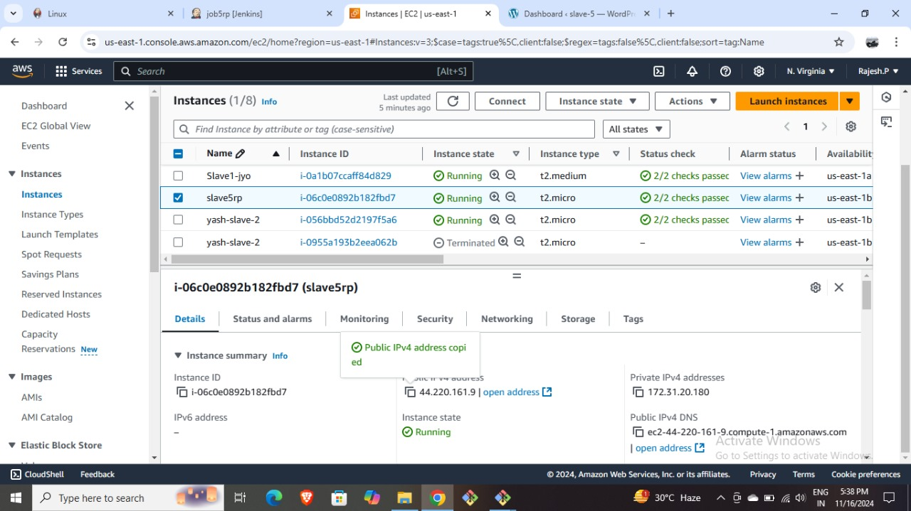
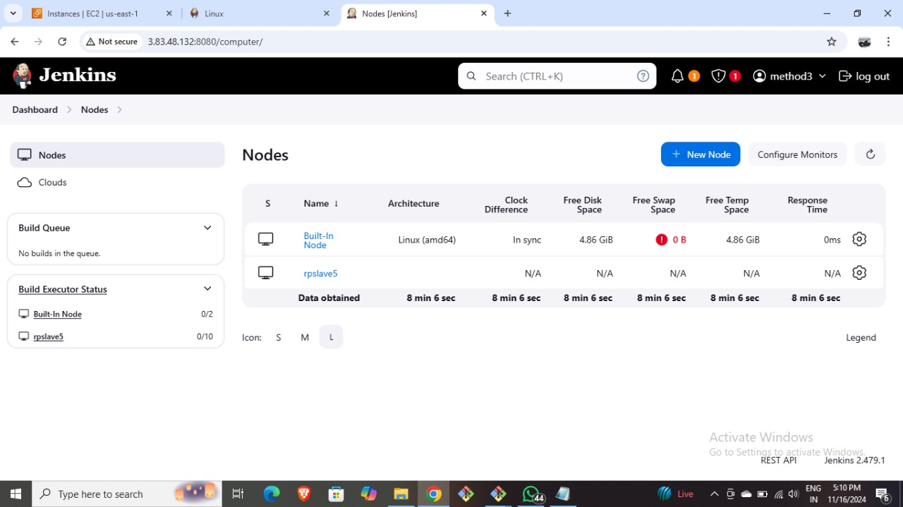
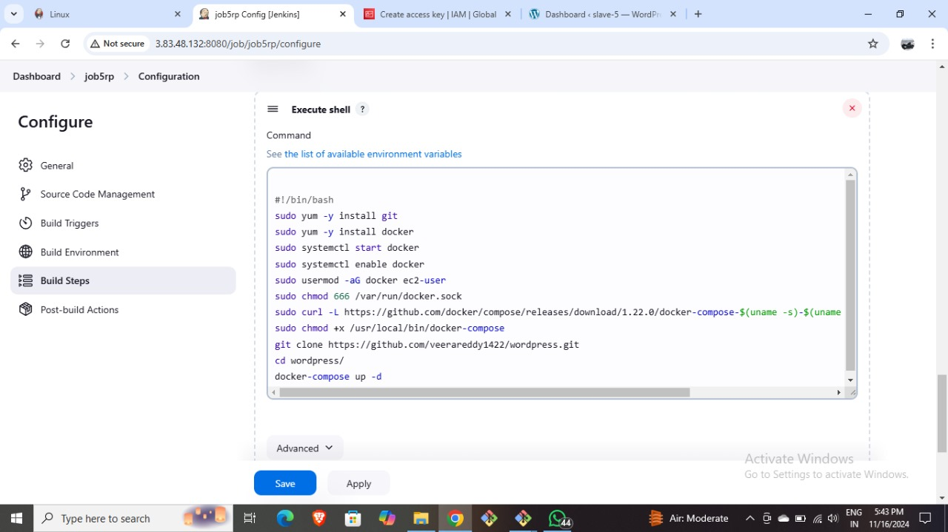


Slide 28
Jostna deploy the word press with k8’s (slave-1)
Launch an EC2 Instances and give name as slave1
Now connect Slave1 to local then install java.
Now give private keys from master server.
create a node for slave1 server in jenkins.
create a job and give slave1 label.
Clone the wordpress application from github.
Now install docker and docker compose in jenkins.
Run the wordpress application in jenkins then push the docker image into dockerhub from jenkins.
Create IAM role and give admin permissions to the slave1.
Create another job then clone the deployment.yaml and service.yaml files then install kops and kubectl in jenkins execut shell.
Now copy the load balancer DNS link and past it on Google browser.
The wordpress application was hosted successfully.

Slide 29







Slide 30
yashwanth deploy word press with Docker Compose file (slave-2)
Launch an EC2 Instances and give name as slave2.
Now connect Slave2 to local then install java.
Now give private keys from master server.
create a node for slave2 server in jenkins.
create a job and give slave2 label.
Clone the wordpress application from github.
Now install docker and docker compose manually.
Run the wordpress application manually.
Now copy the slave2 Public IP and past it on Google browser.
The wordpress application was hosted successfully.

Slide 31





Slide 32
Vinay deploy word press with Terraform (slave-3)
Launch an EC2 Instances and give name as slave3.
Now connect Slave3 to local then install java.
Now give private keys from master server.
create a node for slave3 server in jenkins.
create a job and give slave3 label.
Clone the terraform script from github.
Give IAM credentials to jenkins.
Now install terraform in jenkins execute shell.
Run the terraform script with terraform commands.
The terraform resources was created.
Now copy the slave3 Public IP and past it on Google browser.
The wordpress application was hosted successfully.

Slide 33





Slide 34
Ramsai deploy the word press with poll-scm, build periodically, webhooks (slave-4)
Launch an EC2 Instances and give name as slave4.
Now connect Slave4 to local then install java.
Now give private keys from master server.
create a node for slave4 server in jenkins.
create a job and give slave4 label.
Clone the terraform script from github.
Give IAM credentials to jenkins.
Now install terraform in jenkins execute shell.
Run the terraform script with terraform commands.
The terraform resources was created.
Add poll-SCM, build periodically and webhooks in jenkins.
Now copy the slave4 Public IP and past it on Google browser.
The wordpress application was hosted successfully.

Slide 35





Slide 36
Thank You

